Slide 1
Learning Outcomes:
Understand what data analytics is and its role in decision making.
Distinguish between types of data analytics.
Explore key tools and technologies used in data analytics.
Discuss real-world applications and challenges.
Yoobee Colleges
Introduction to Data Analytics
Notes:
Week 1

Slide 2
What is data analytics
Data analytics is an important field that involves the process of collecting, processing, and interpreting data to uncover insights and help in making decisions.
Data analytics is the practice of examining raw data to identify trends, draw conclusions, and extract meaningful information.
This involves various techniques and tools to process and transform data into valuable insights that can be used for decision-making.

Slide 3
Data Analytics vs Data Science
S.No | Data Analytics | Data Science
a) | Data Analyst | Data Scientist
b) | Higher level tools (Excel, Tableau, PowerBI, etc.) | Lower-level tools (Programming Languages, Database systems)
c) | Skills of tools | Knoweledge of theories
d) | Medium level of statistics | High level of statistics
e) | Well-paid | Higher-paid

Slide 4
Types of Data Analytics
Descriptive Analytics
Diagnostic
Analytics
Predictive
Analytics
Prescriptive
Analytics
Cognitive
Analytics
Deals with
What
happened in
the past
Deals with
Why
It happened in the past
Deals with
What Will
happen in the future
Deals with
How
to make it happen
Deals with
Artificial Intelligence

Slide 5
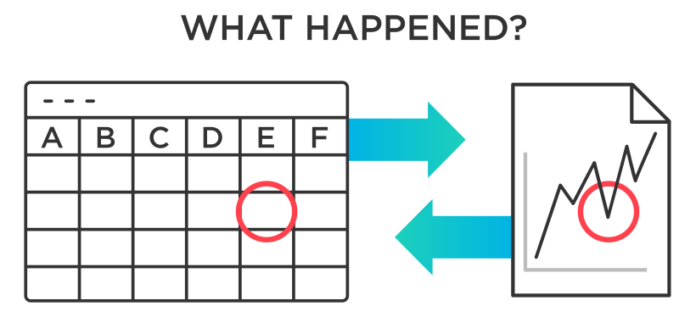
Descriptive Analysis
There are two main techniques used in descriptive analytics:
Data aggregation: Data aggregation is the process of gathering data and presenting it in a summarized format.
Data mining: Data mining is the analysis part. This is when the analyst explores the data in order to uncover any patterns or trends.The outcome of descriptive analysis is a visual representation of the data—as a bar graph, or a pie chart.
Descriptive Analytics
Deals with
What
happened in
the past
—-—-
—-—-
—-—-

Slide 6
Diagnostic Analytics
It provides deeper insights into why specific events, outcomes or behaviors occurred. It aims to reveal the causes that lead to the results.
Define the problem: Clearly define the problem you want to investigate
Data collection: Collect relevant historical data related to the problem
Data preprocessing: Clean the data to ensure the quality and reliability
Statistical analysis: Perform relevant tests
Data visualization: Visualize them to clearly identify their relationships
Anomaly detection: Identify unusual or unexpected patterns in the data
Diagnostic
Analytics
Deals with
Why
It happened in the past

Slide 7
Predictive Analytics
Predictive
Analytics
Predictive analytics seeks to predict what is likely to happen in the future.
Based on past patterns and trends, data analysts can utilize predictive models which estimate the likelihood of a future event or outcome.
Machine learning algorithms can be helpful in predictive analysis.
Deals with
What Will
happen in the future

Slide 8
Perspective Analytics
Prescriptive
Analytics
Prescriptive analytics goes beyond what has happened, why it happened, and what might happen to determine what should be done next.
Prescriptive models are used to calculate all the possible “routes” a company might take to reach their goals to determine the best possible option.
Deals with
How
to make it happen

Slide 9
Cognitive Analytics
Cognitive Analytics combines Artificial Intelligence and Data Analytics to learn from the data and extract the hidden patterns from data. It brings all the data sources.
This data comes from everywhere: sensors used to gather climate information, posts to social media platforms, voices, images and videos, purchase transaction records, and mobile phone GPS signals, etc.
How does Cognitive Analytics work?
Understanding natural language and human interactions.
Generating and evaluating the Evidence-based hypothesis.
Adapting and learning from user selections and responses.
Cognitive
Analytics
Deals with
Artificial Intelligence

Slide 10
Technologies and Tools used in Data Analytics
Category | Technology/Tool | Purpose
Data Storage | Hadoop, Amazon S3, Google BigQuery | Store and manage large volumes of structured and unstructured data
Data Processing | Apache Spark, Apache Flink, Pandas | Fast processing and manipulation of large datasets.
Data Analysis | Python (NumPy, Pandas) | Perform statistical analysis and build machine learning models
Data Visualization | Tableau, Power BI, Matplotlib | Create interactive and interpretable data visualizations.
Data Integration | Apache NiFi, Talend, informatica | Extract, transform and load (ETL) data from multiple source.
Machine Learning and AI | Scikit-learn, TensorFlow, and PyTorch | Develop predictive and prescriptive analytic models.

Slide 11
Analytics Lifecycle
Data Collection (20%, Gathering relevant data is critical to ensure meaningful analysis.)
Cleaning (25%, Most effort is spent here; ensures data quality by handling errors, duplicates, missing values.)
Exploration (15%, Understand patterns, trends, and anomalies; drives hypothesis formation.)
Modeling (15%, Develop predictive or descriptive models based on cleaned, explored data.)
Visualization (10%, Communicate insights effectively through charts, graphs, and dashboards.)
Actionable Insights (15%, Translate analysis into decisions or strategic actions.)
Reference: EMC Education Services, Data Science and Big Data Analytics, Wiley (2015)

Slide 12
Application and Challenges of Data Analytics
Applications | Challenges
Healthcare: Predictive diagnostics, patient monitoring. | Data Privacy: Ensuring compliance with data protection laws.
Finance: Fraud detection, algorithmic trading. | Data Quality: Handling missing, inconsistent, or noisy data.
Retail: Customer segmentation, inventory forecasting. | Scalability: Processing and storing large-scale datasets efficiently.
Transportation: Route optimization, demand prediction. | Skill Gap: Shortage of skill professionals in data science.
Agriculture: Yield protection, smart irrigation. | Tool Integration: Combing tools across platforms and formats.
Manufacturing: Predictive maintenance, process automation. | Real-time processing: Need for low-latency analytics solutions.
References: 1) Katal, A., Wazid, M., & Goudar, R.H. (2013). Big Data: Issues, Challenges, Tools and Good Practices, IEEE Paper 2) https://www.weforum.org/agenda/2021/10/data-governance-ethics/

Slide 13
Summary and End of Session
Data Analytics is central to digital transformation, turning raw data into actionable insights for smarter decision-making.
Key Roles: Identifying patterns, predicting outcomes, and recommending actions across industries like healthcare, retail, and agriculture.
Challenges: Data privacy, quality issues, integration, and real-time processing remain key obstacles.
The Future: Mastering data analytics tools and techniques positions you to thrive in a data-driven world, empowering innovation and informed decisions.

Slide 14

Q&A?

